Slide 1
GESTURE CONTROLLED GAME
Hello and welcome to all of you.

Slide 2

A picture is worth a thousand words

Slide 3
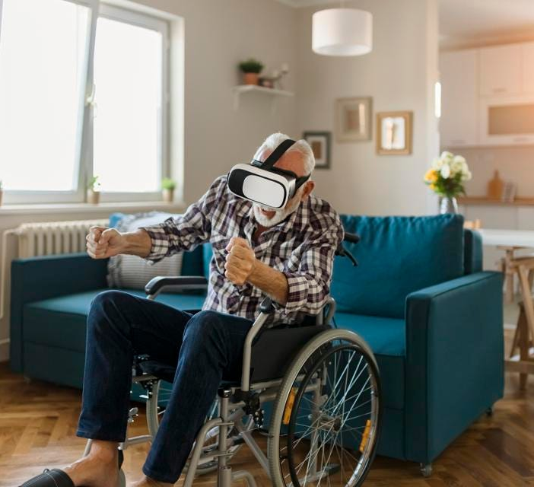
How today disabled play games
This is how specially abled people play game which cost a lot.

Slide 4

Traditional Education Technique
This is how students gets bored due to traditional education system.

Slide 5
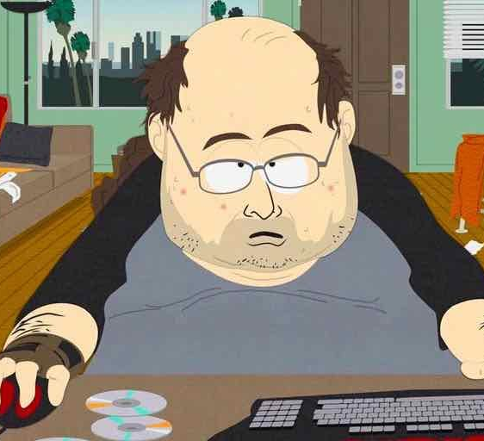
Fitness Problem
This is how today’s lifestyle is effecting our life due to less workout.

Slide 6
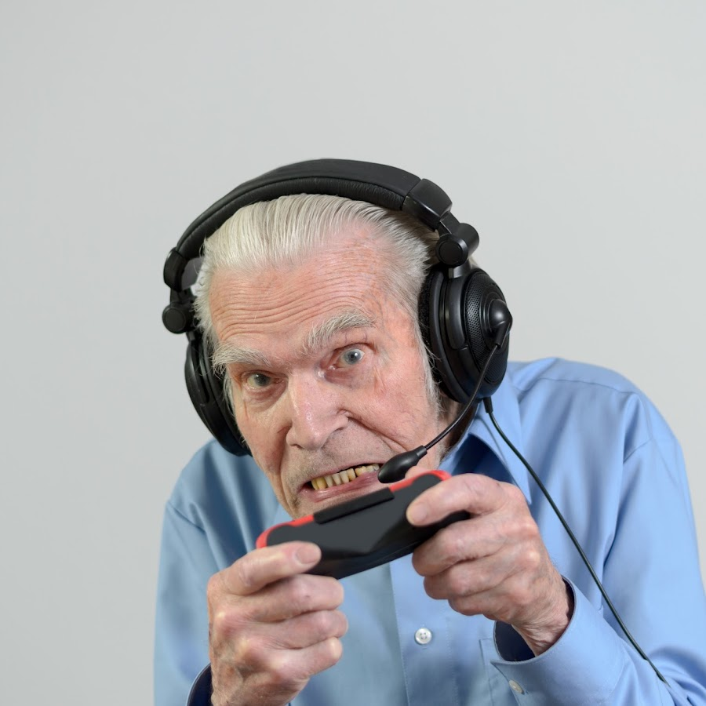
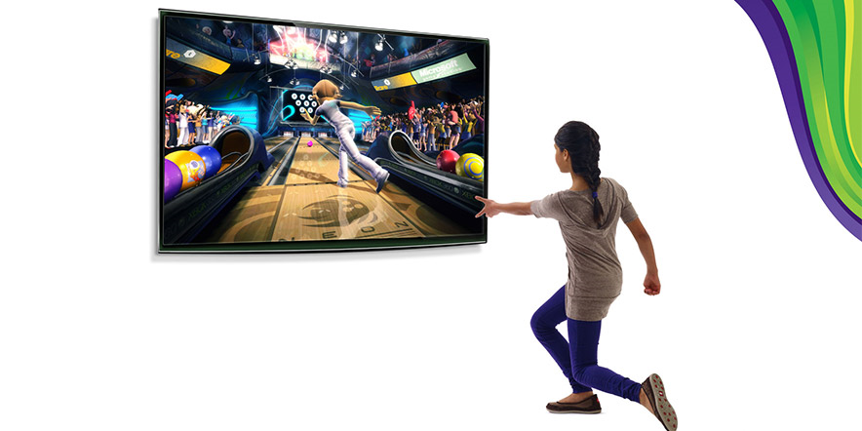
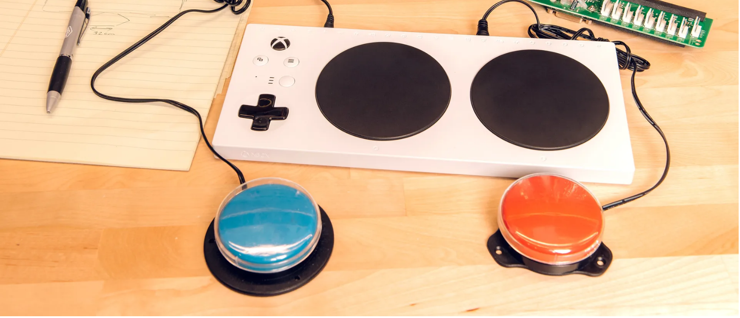
INTRODUCTION
Video games are among the most popular forms of entertainment in the modern world. Gesture Controlled Game will provide:
Use a player's physical movements to control gameplay.
Adds a new level of immersion and engagement.
People from all ages can play to be fit and get entertained.
Cost effective.

Slide 7
Awesome words

Slide 8
—Anonymous
"Gesture controlled gaming allows you to become the controller, immersing you in a world where your movements bring the game to life."

Slide 9


Our Purpose and Objective
Immersive gaming
Specially abled
Providing a unique and innovative gaming experience that cannot be achieved with traditional controller-based games
Providing a challenging and rewarding gameplay experience that encourages specially abled players to improve their skills and progress through the game

Slide 10

Our Objective
Cost-Effective
Physical Activity
Giving a cost-effective solution to those who are specially abled.
Unlike other games this will add physical activity of the users which will make them fit.

Slide 11




It’s Scope
Entertainment
Health and fitness
Rehabilitation
Military and defense
Education
Provide a new and Exciting way for players to engage with video games
Used as a tool for promoting physical activity and exercise
Used as a rehabilitation tool for individuals recovering from injuries or illnesses.
Can be used to train military personnel in various skills, such as marksmanship, tactics, and communication.
Can be used as an educational tool to teach a range of subjects

Slide 12
26,800,000
26.8 million people are diabled in India only.

Slide 13
135,000,000
92,000,000
1,400,000
People are suffering from obesity
Students are enrolled for higher education in india
Active personnel's are working in India

Slide 14
Proposed System
HARDWARE REQUIREMENTS
GESTURE RECOGNITION
GAME CONTROL
Include a camera or sensor that can track the player's movements and a computer or console to run the game
Module that can identify the gestures made by the player. It can be achieved by computer vision and some machine learning algorithms.
Module must be able to map the gestures made by the player to the game controls.

Slide 15
Proposed System
Create Account
USER
If account exists
LOGIN
Preview Webcam
If active
Create Gestures
Captures Gestures
Start Game
View Instructions
Create Moves
Quit Game

Slide 16

Feasibility study
Technical feasibility: This will include sensors or cameras capable of capturing and interpreting user gestures, as well as software tools and libraries for gesture recognition and game development.

Slide 17

Feasibility study
Economic feasibility: This will include the cost of hardware and software development, marketing and advertising, and ongoing support and maintenance.

Slide 18

Feasibility study
Operational feasibility: This might include aspects such as project management, staffing and training, supply chain management, and legal and regulatory compliance.

Slide 19

Feasibility study
User acceptance: The success of a gesture-controlled game would depend on the acceptance and adoption of the game by users.

Slide 20
Life Cycle Model

Slide 21
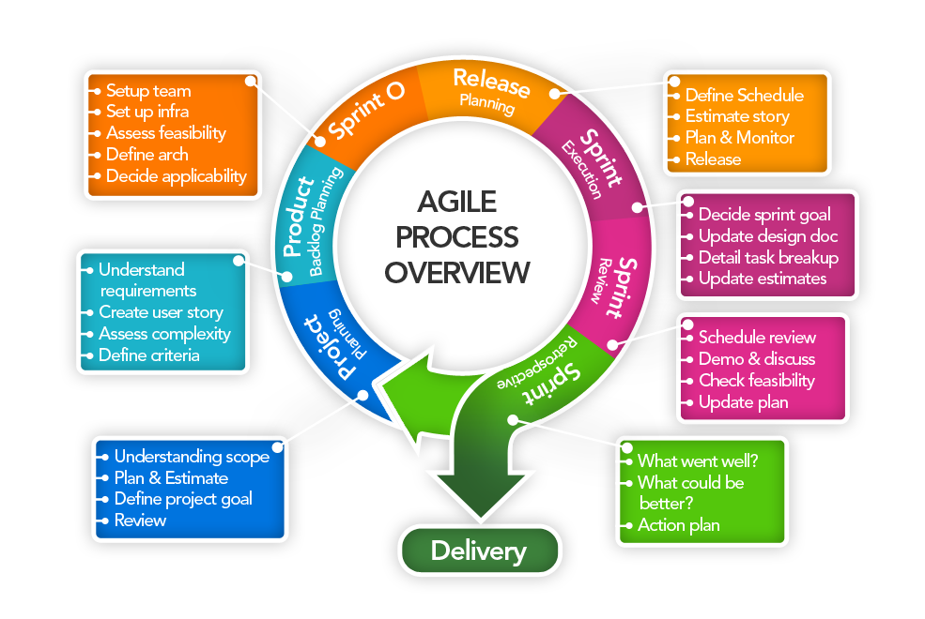
Life Cycle Model

Slide 22
UML Diagrams

Slide 23
USE CASE DIAGRAM
ACCESS WEB CAM
USES GESTURES
START GAME
User
View Instruction
Make A Move
QUIT GAME

Slide 24
USE CASE DIAGRAM
Develop Algorithm
Develop Game Mechanic
Update And Maintain
Developer
Test And Debug
Co-ordinate other team members

Slide 25

Module Discription

Slide 26


MODULE DISCRIPTION
Gesture Recognition Module: It would include software that utilizes sensors or cameras to recognize and interpret the player's hand or body movements.

Slide 27



MODULE DISCRIPTION
Game Control Module: This module would include the game's core logic, including rules, scoring, and objectives and gesture recognition algorithms.

Slide 28


MODULE DISCRIPTION
User Interface Module: This module is responsible for designing and implementing the user interface for the game, including the visual design, user input controls, and feedback to the user.

Slide 29

MODULE DISCRIPTION
Networking Module: This module is responsible for handling network communication between players, such as multiplayer or online gameplay.

Slide 30

MODULE DISCRIPTION
Data Management Module: This module is responsible for managing game data, such as user profiles, scores, and game progress.

Slide 31


MODULE DISCRIPTION
Motion Sensing Module: This module would include software that handles the player's hand or body movements and translates them into game commands.

Slide 32
Class Diagram
MUSIC
GAME
Actor
files
params
x
play()
Actor
y
sound
pos
draw()
image
update()
move()

Slide 33
Sound
Camera
Image
play()
stream
path
frame
files
start()
Built()
Gesture Control
handsPosition
recognize()
update()

Slide 34
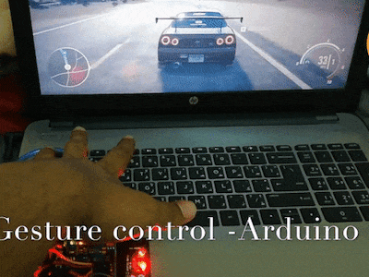
Conclusion
Gesture-controlled games provide a unique and immersive gaming experience that leverages the latest technology to enhance player engagement, enjoyment, and accessibility.

Slide 35



Conclusion
Gesture-controlled games can promote physical activity, improve accessibility for people with disabilities, expand the market for video games, and provide a new and innovative way to play games.

Slide 36


Conclusion
Gesture-controlled games represent an exciting and rapidly evolving field in gaming, with many opportunities for innovation and growth.

Slide 37
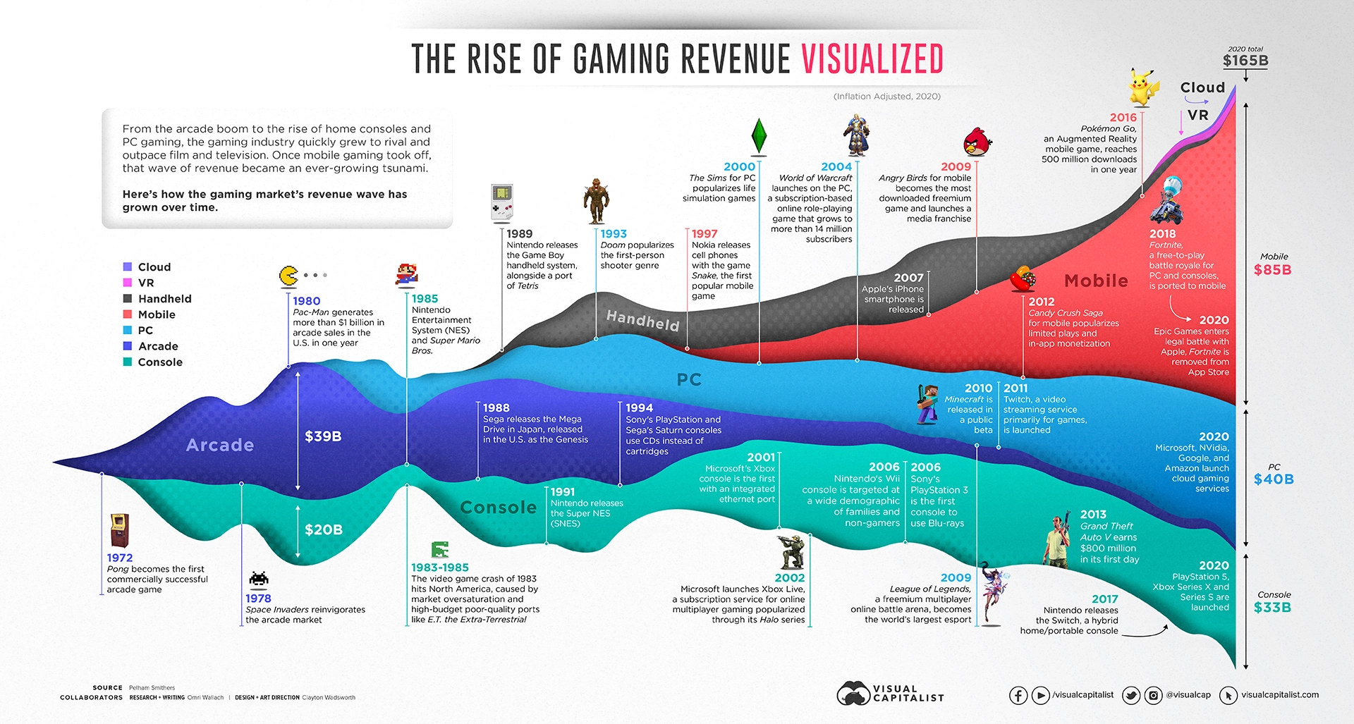
Market size

Slide 38
Thanks!
Do you have any questions?
navneetkumarroy5740084@gmail.com
+91 7518196633

